Slide 1
eBay

Slide 2
eBay Project
Index
Web Scraping: eBay Sneaker Category
Scrape data for all products from the first 5 pages.
Extract details: product link, product title, price, reviews, likes.
Data Handling
Export scraped data into a CSV file.
Import data from the CSV file for further analysis.
Data Cleaning/Wrangling
Handle missing values.
Perform feature engineering.
Replace incorrect or inconsistent values.
Correct data structure issues.
Exploratory Data Analysis (EDA)
Analyze the cleaned data to extract insights.
Visualize key patterns and trends.

Slide 3
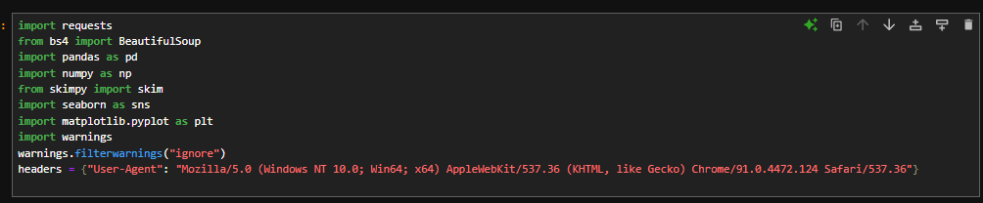
IMPORT LIBRARIES

Slide 4
Step-1 Ebay Web-scraping

Slide 5
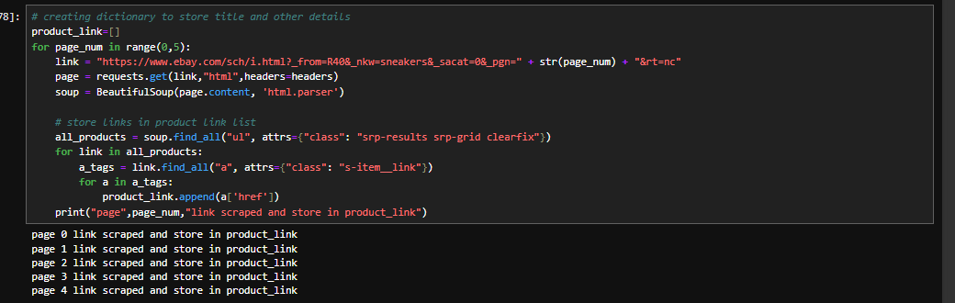
1.Create a list to store product link which are scraped from the ebay website. 2. Requests-> to extract html data from website. 3. Soup -> to extract particular tags for the product links. 4. Using loop extract first 5-pages products link for scraping details like: title, price, review, likes NOTE: each page show only 60 products

Slide 6
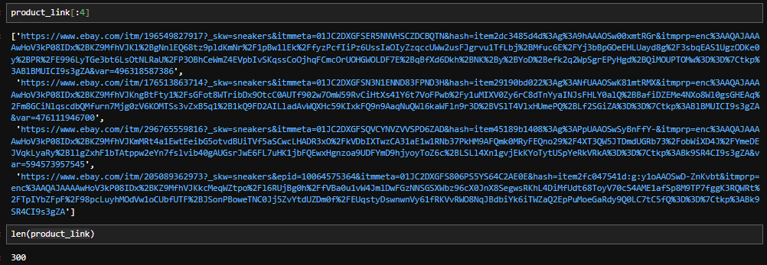
Extracted product link and total links extracted

Slide 7
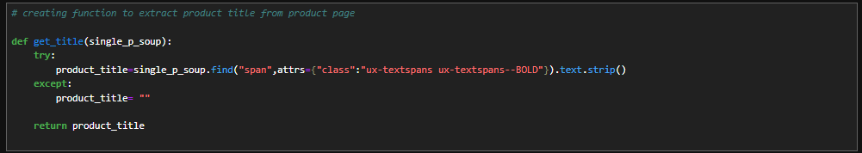
Create function to extract title from link through new variable single_p_soup

Slide 8
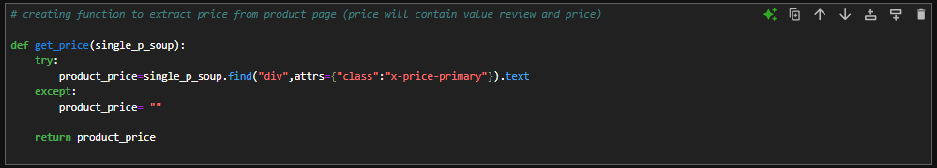
Create function to extract Price from link through new variable single_p_soup

Slide 9
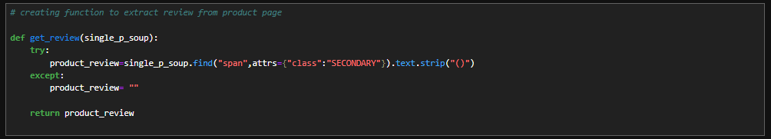
Create function to extract Review from link through new variable single_p_soup

Slide 10
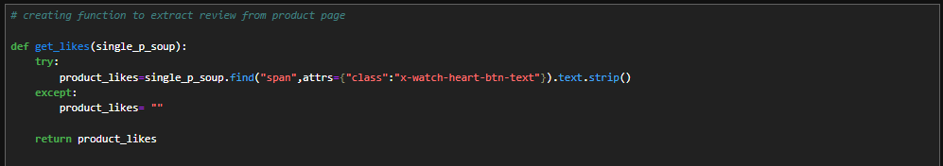
Create function to extract Likes from link through new variable single_p_soup

Slide 11
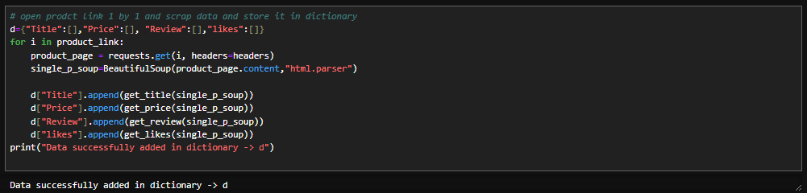
Create dictionary to store scraped data

Slide 12
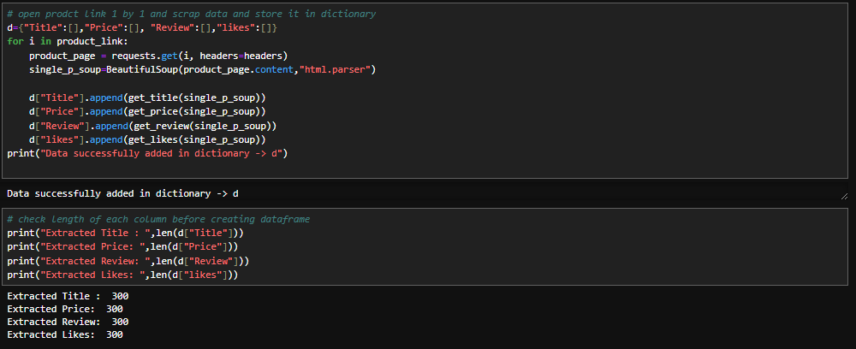
Create dictionary to store scraped data from product page from links which stored into product links list and total scraped data length

Slide 13
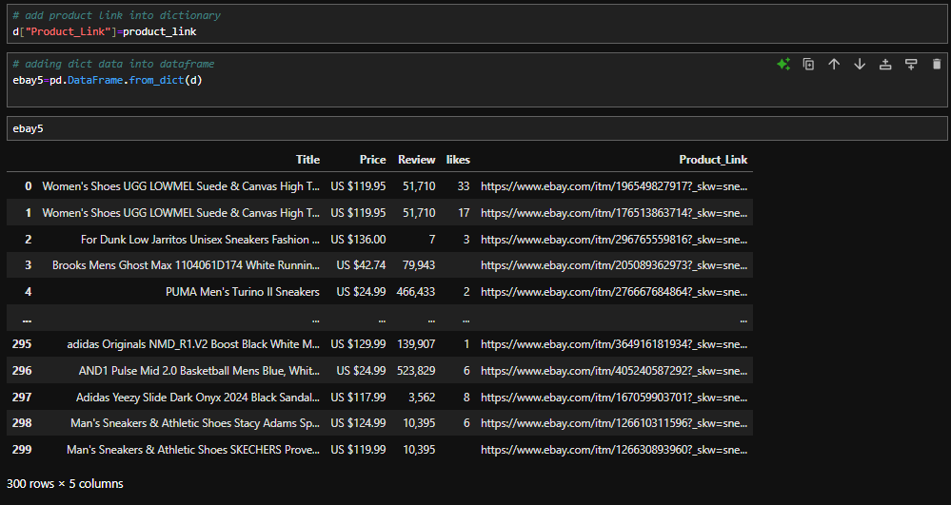
add prduct links into dictionary and create dataframe from dictionary with name ebay5

Slide 14
Step-2 Import & Export Data

Slide 15
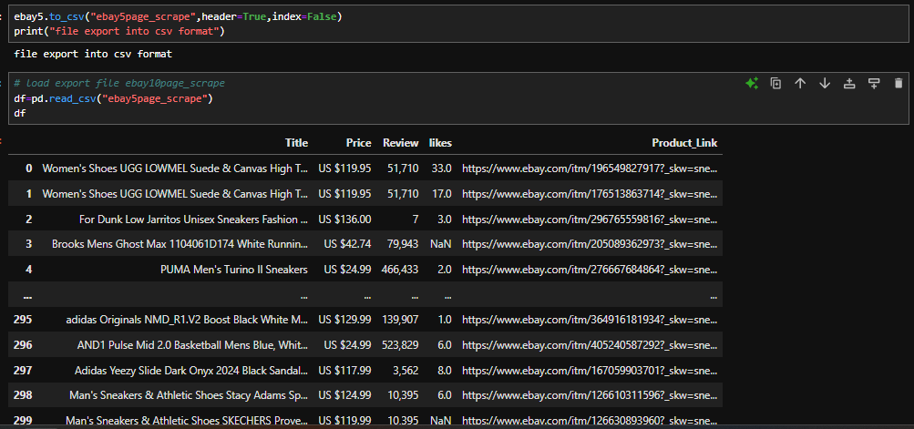
Export scraped data into csv format and import the same

Slide 16
Step-3 Data Analysis and Data Cleaing

Slide 17
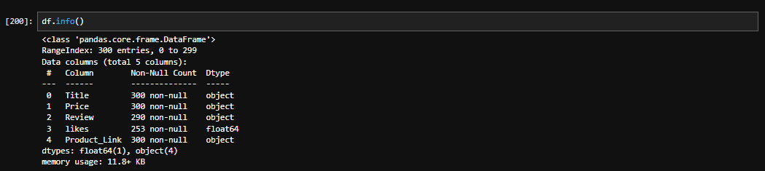
Data summary to check dtype, missing values, memory consumption

Slide 18
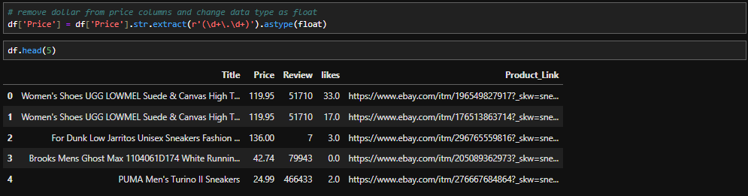
Price column correction removed dolloar sign and change dtype as float

Slide 19
Data summary to check dtype, missing values, memory consumption

Slide 20
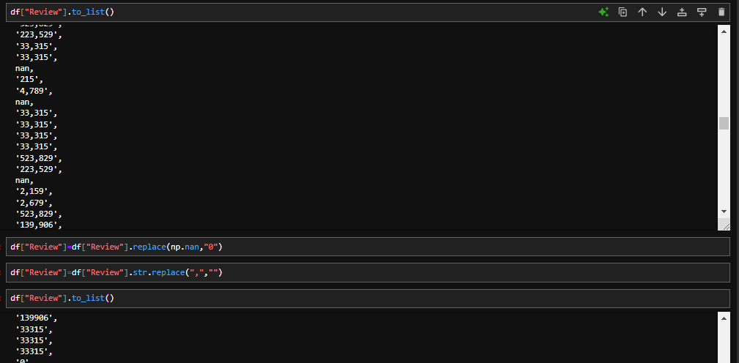
Replace “nan” value with “0” in review column before change data type

Slide 21
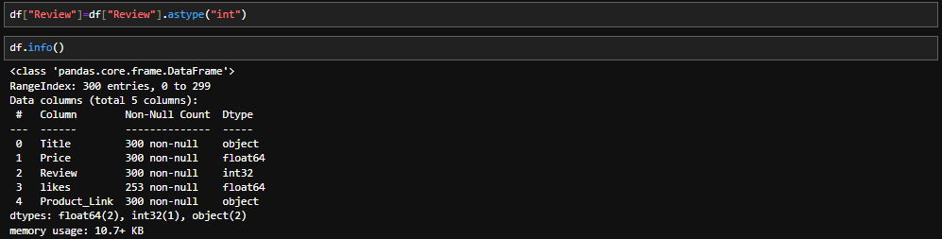
Change review column datatype object to int32

Slide 22
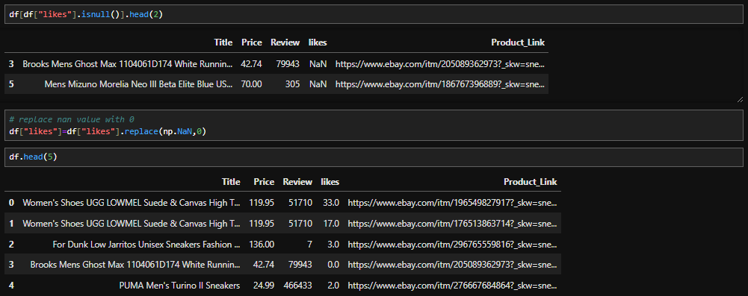
Fill missing values with 0 in likes columns using replace function

Slide 23
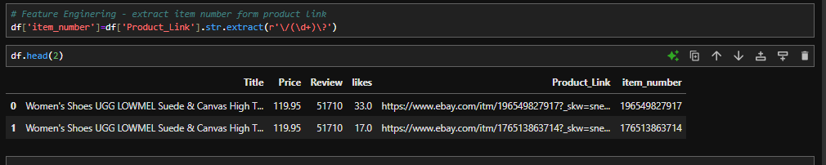
Extract item number form product link column and create new column with name item_number

Slide 24
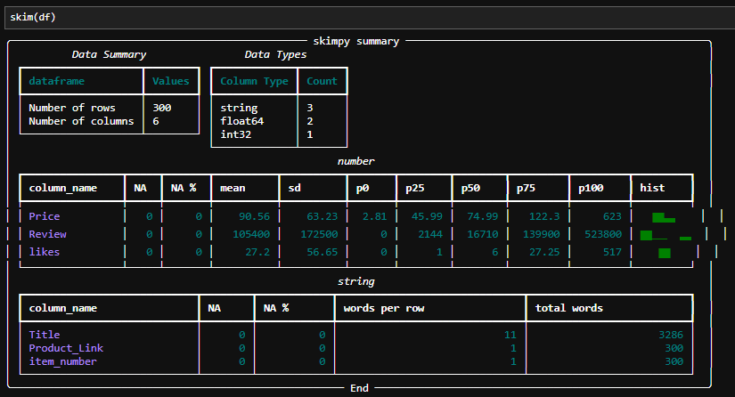
Check again data summary by importing skimmy for better understanding

Slide 25
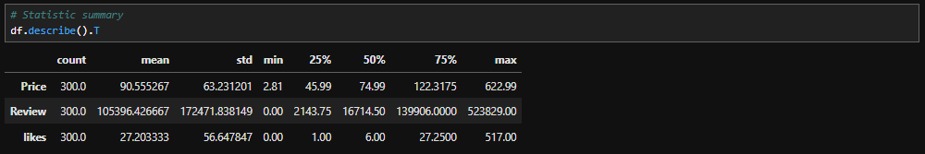
Check again data summary by importing skimmy for better understanding

Slide 26
Step-4 Exploratory Data Analysis (EDA)

Slide 27
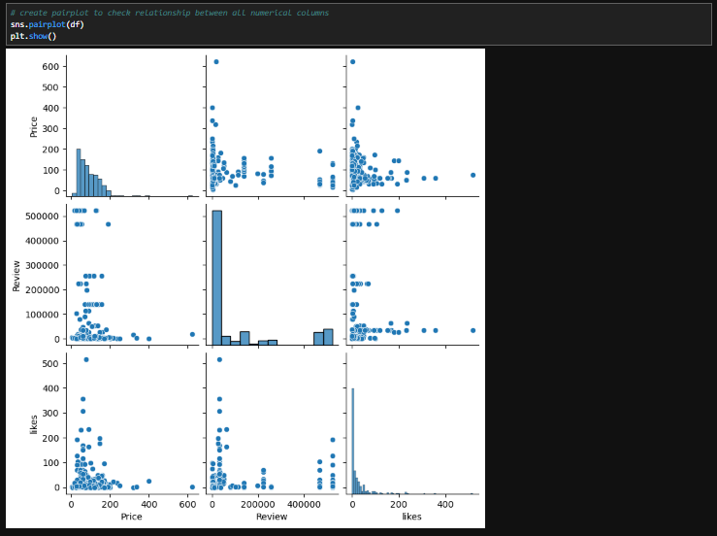
Check relation between all numerical columns

Slide 28
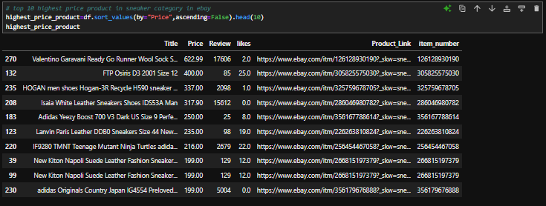
10 Product which have highest price among all products

Slide 29
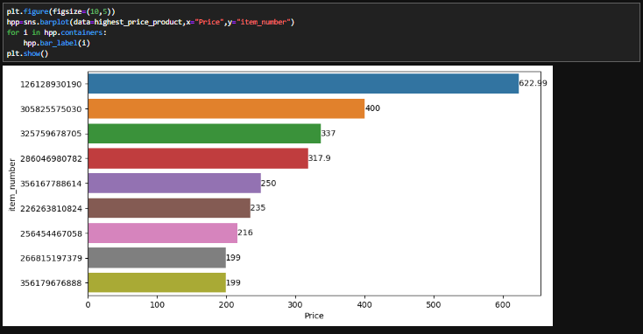

Slide 30
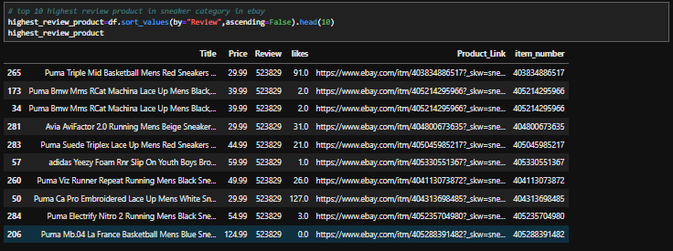
10 Product which have highest review among all products

Slide 31
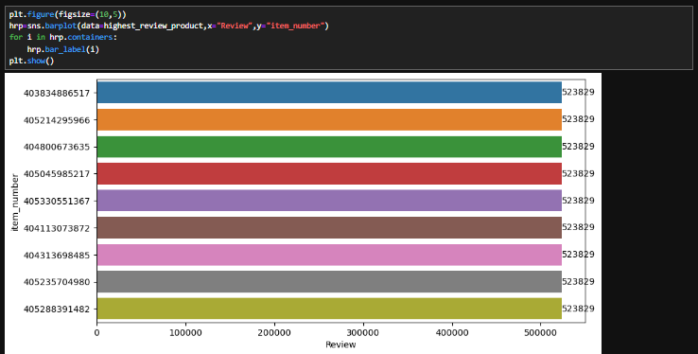

Slide 32
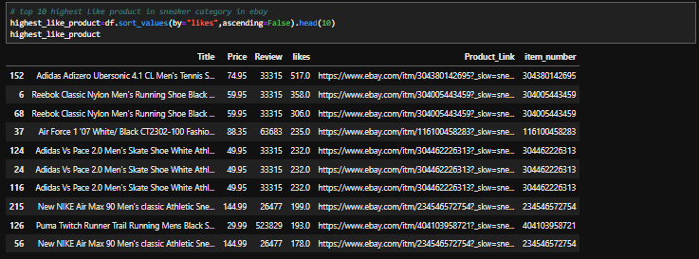
10 Product which have highest likes among all products

Slide 33
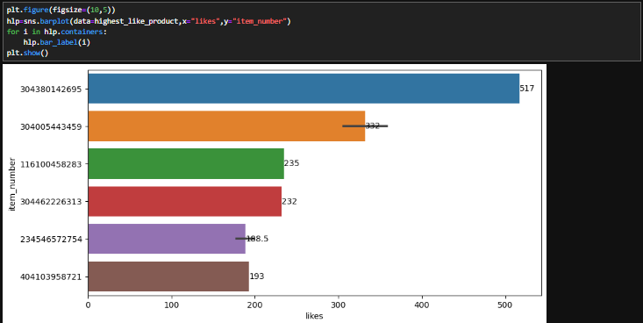

Slide 34
Thank You
linkedin: www.linkedin.com/in/nishant-kumar-data-analyst
github: https://github.com/Nishant6020

